Slide 1
gRoup members
Mohammad jawad khan (p19-0053)
Zohaib khan (p19-0095)
Ashger ali (p19-0078)

Slide 2
modern hotel network system design and implementation inter-vlan , dhcp server , port-security , ssh , wireless network

Slide 3
project details
As a part of our semester project on computer networks. We are designing and implementing the Modern Hotel network. The hotel has three floors.
On the first floor there are three departments (Reception, Store, and Logistics)
On second floor there are three departments (Finance, HR, and Sales Marketing)
On third floor hosts the IT(Information Technology) and Admin department.

Slide 4
Project details
There are three routers connecting to each floor ( all placed in the server room in the IT department).
All routers are connected to each other using a serial DCE cable.
The network between the routers should be 10.10.10.0/30, 10.10.10.4/30, 10.10.10.8/30.

Slide 5
project details
Each floor is expected to have one switch (placed on the respective floor).
Each floor is expected to have WIFI networks connected to laptops and phones. Each department is expected to have a printer.
Each department is expected to be a different VLAN with the following details.

Slide 6
( 1st Floor )
Reception - VLAN 80, Network of 192.168.8.0/24
Store - VLAN 70, Network of 192.168.7.0/24
Logistics - VLAN 60, Network of 192.168.6.0/24

Slide 7
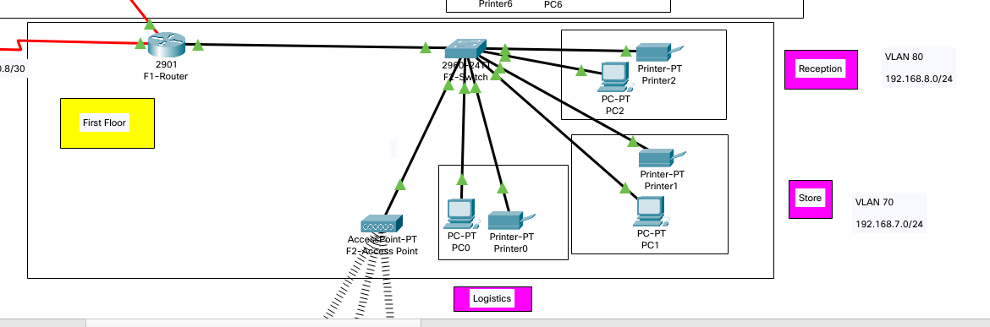
( 1st Floor topology )

Slide 8
( 2nd Floor )
Finance - VLAN 50, Network of 192.168.5.0/24
HR - VLAN 40, Network of 192.168.4.0/24
Sales - VLAN 30, Network of 192.168.3.0/24

Slide 9
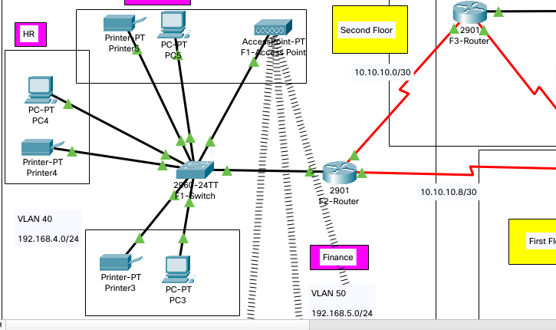
( 2nd Floor topology )

Slide 10
(3rd Floor)
Admin - VLAN 20, Network of 192.168.2.0/24
IT - VLAN 10, Network of 192.168.1.0/24

Slide 11
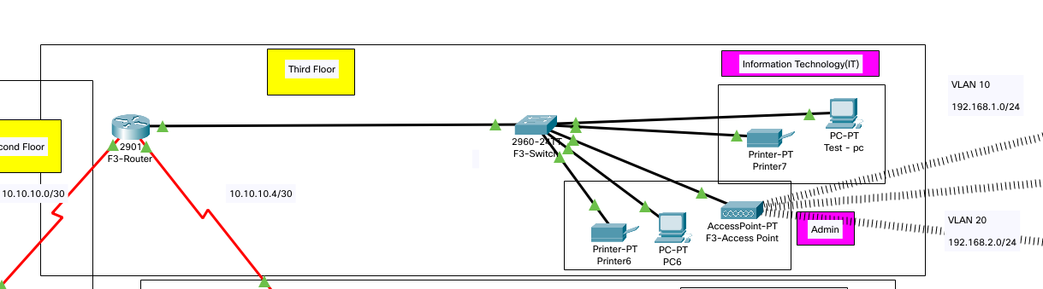
( 3rd Floor topology )

Slide 12
project details
Use OSDF as the routing protocol to advertise routes.
All devices in the network are expected to obtain an IP address dynamically with their respective router configured as the DHCP server.
All the devices in the network are expected to communicate with each other. Configure SSH in all the routers for remote login. In IT department, the PC called Test-PC to port fa0/1 and use it to test remote login.
Configure port security to IT-department switch to allow only Test-PC to access port fa0/1 (we use sticky method to obtain mac-address with violation mode of the shutdown.)

Slide 13
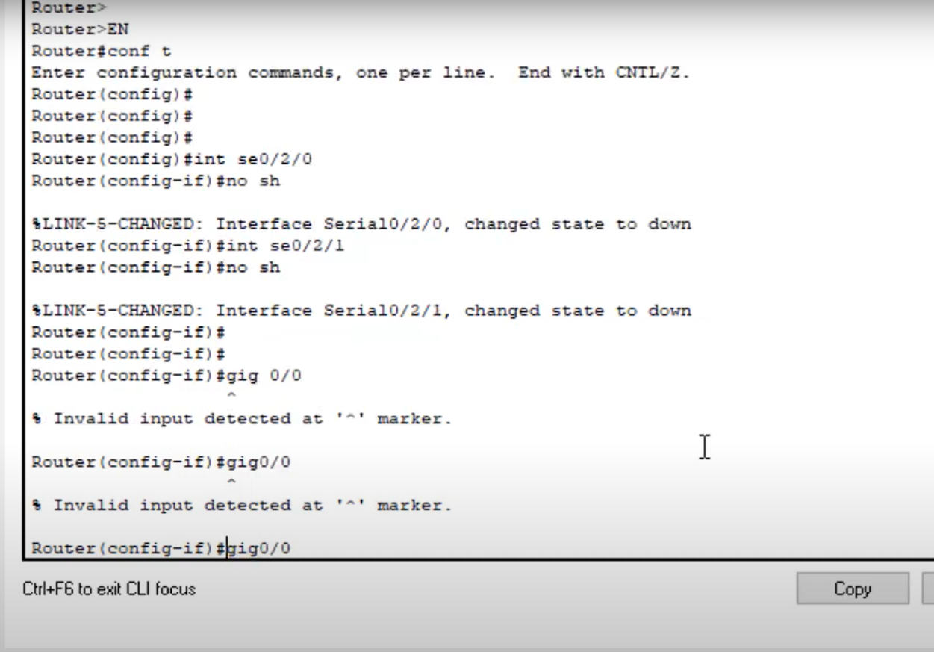
No shutdown state

Slide 14
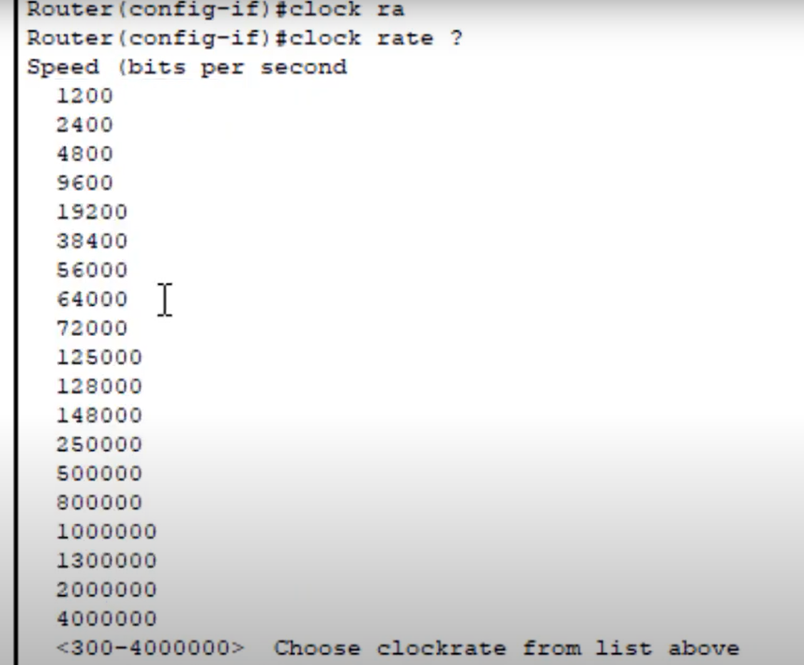
Set clock rate

Slide 15
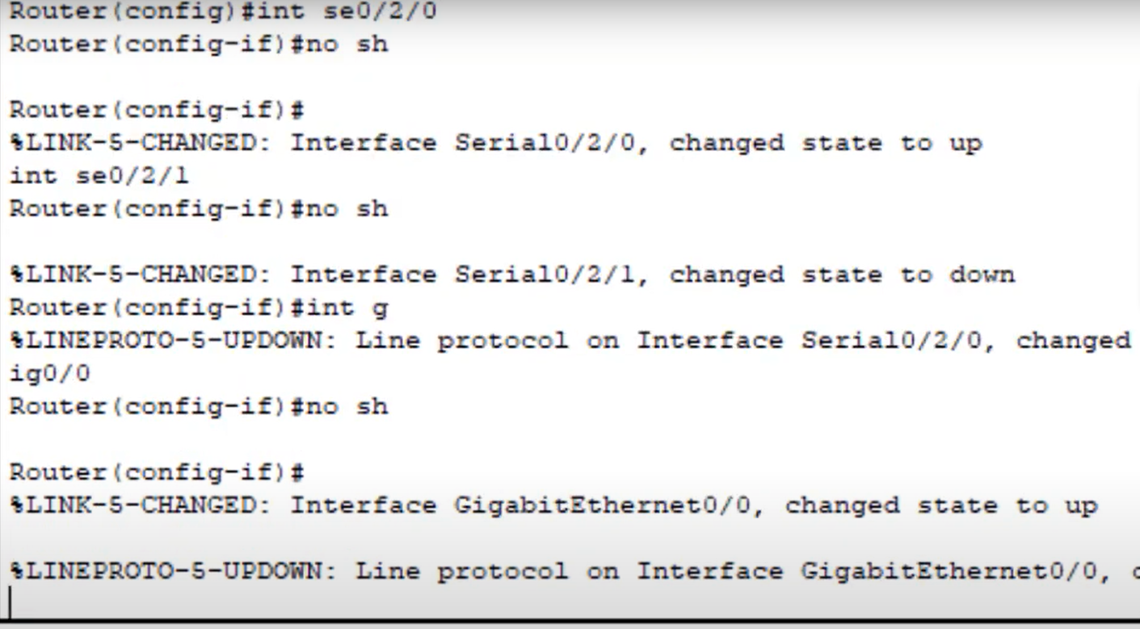
Routers

Slide 16
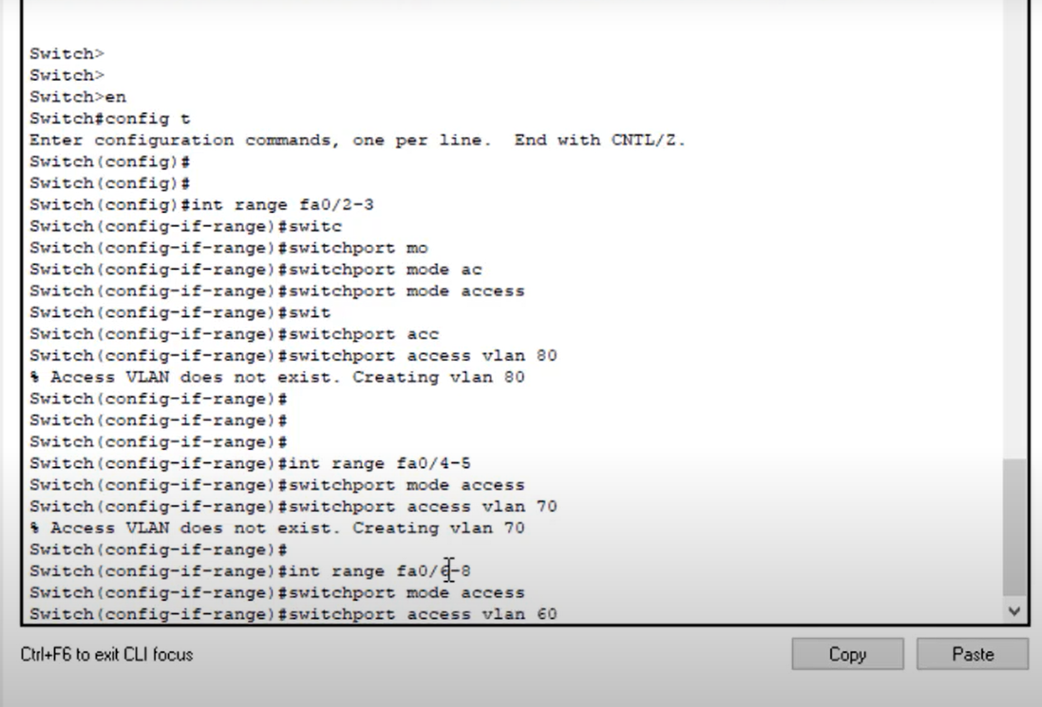
Vlan implementation

Slide 17
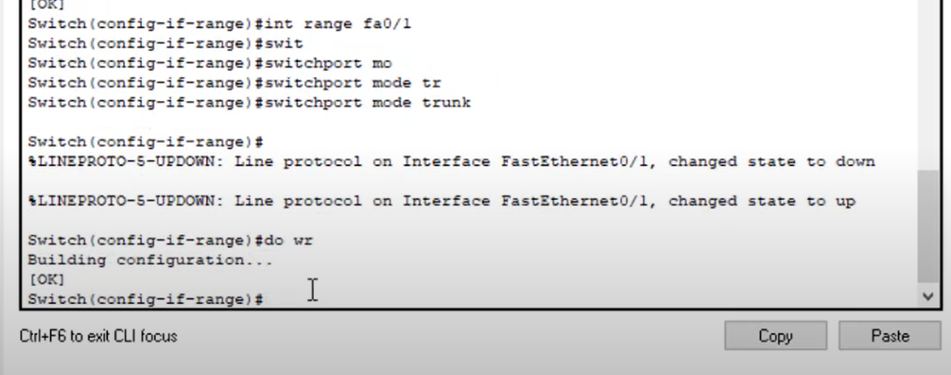
For traffic interface

Slide 18
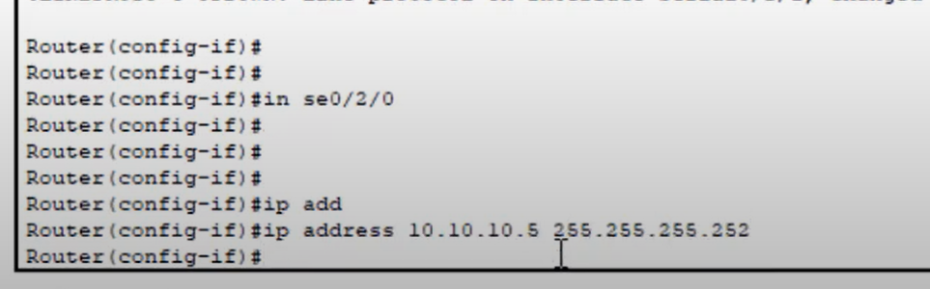
Router configration

Slide 19
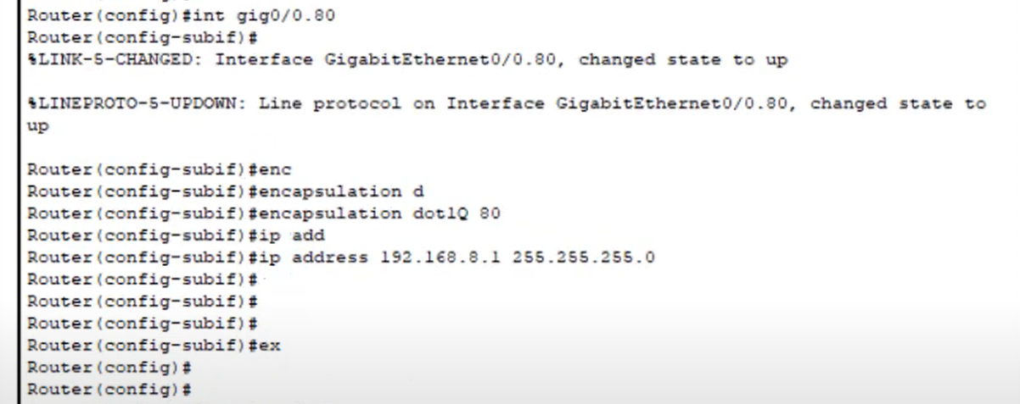

Slide 20
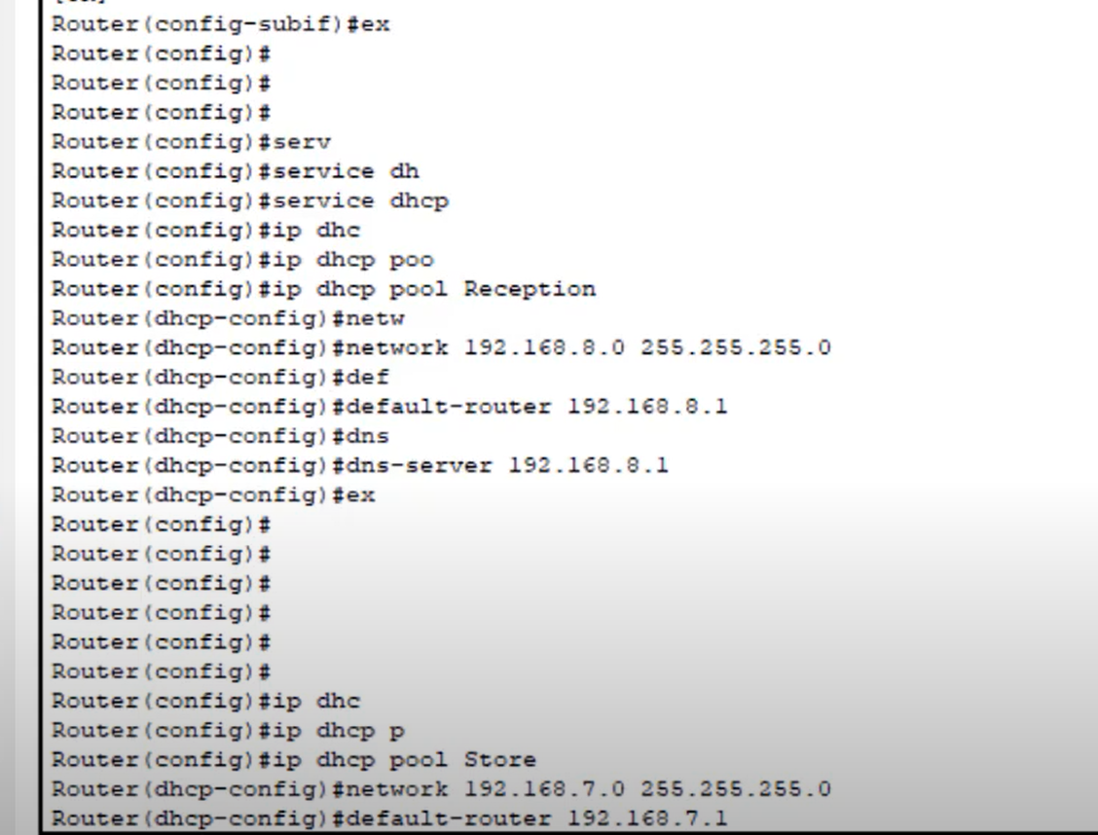
Dhcp ips

Slide 21
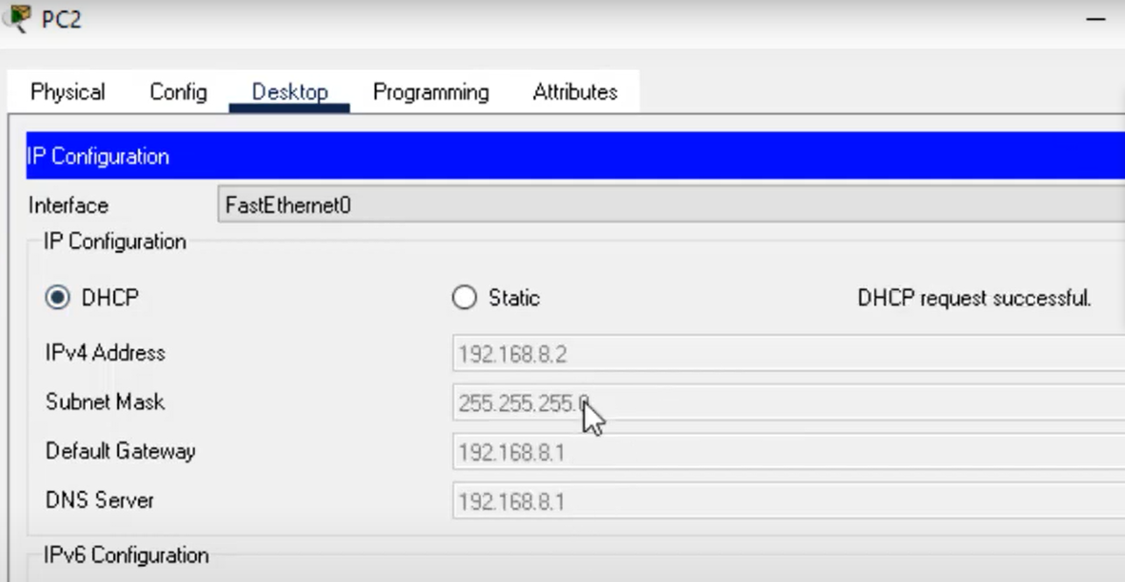
result

Slide 22
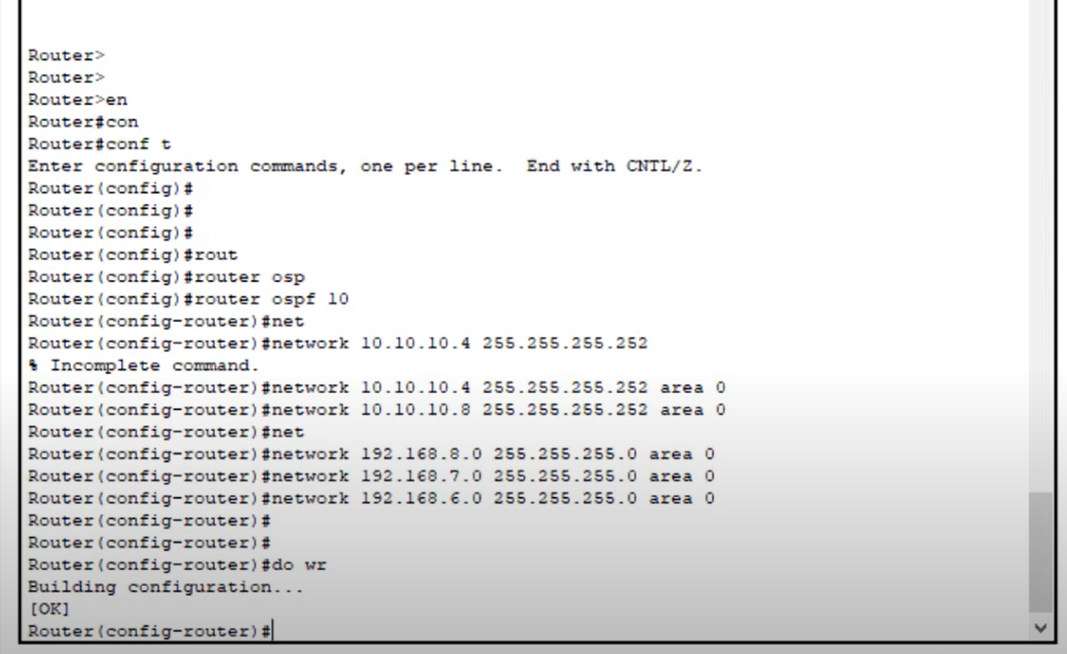
Ospf protocol

Slide 23
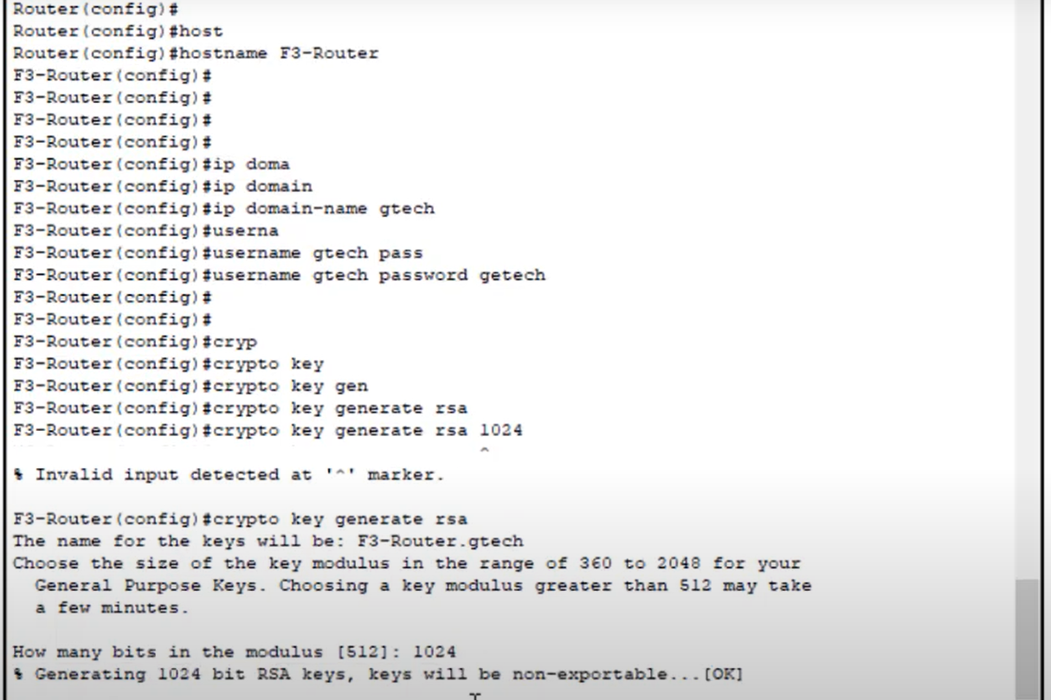
Ssh implementation

Slide 24
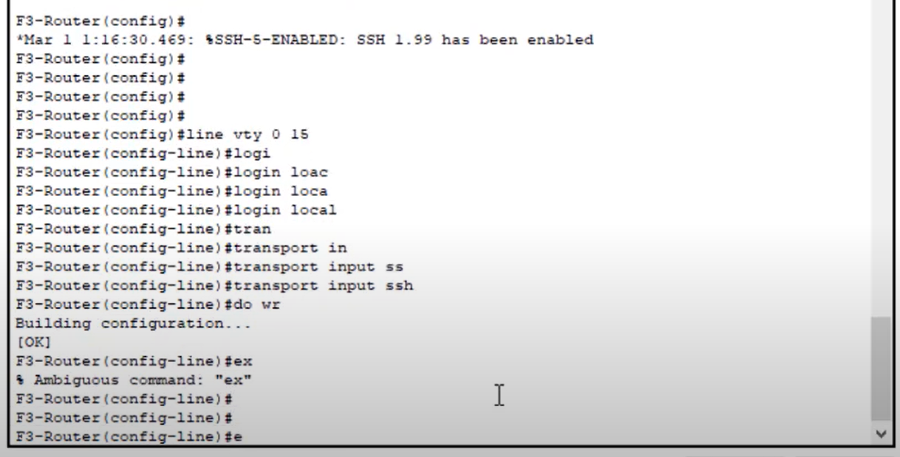
Ssh implementation

Slide 25
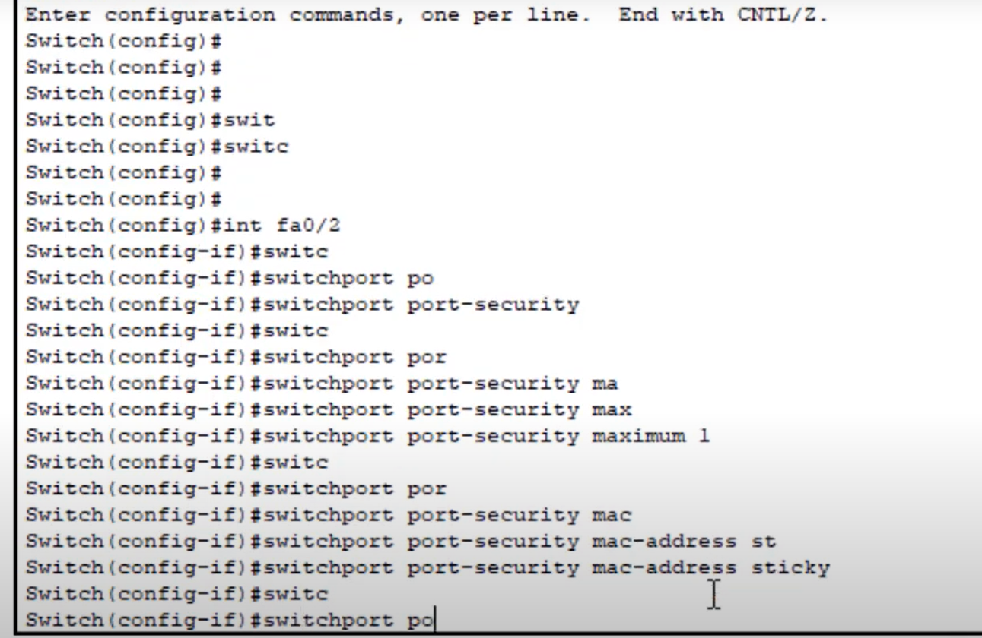
Port-security

Slide 26

Thank you!

